Slide 1
8:30-9: Recap, Check in, Agenda

Slide 2
Welcome back!!! Let’s recap
Day 1: Cognitive Services
8:30-9:15: Setup
9:15-10: Cognitive Services and PictureBot Introduction
10-12: Lab 1: Computer Vision
12-1: Lunch
1-1:30: Custom Vision Service Introduction
1:30-2: Lab 2: Custom Vision Service I: Image Classification
2-2:30: Lab 3: Custom Vision Service II: Object Detection
2:30-3:45: Lab 4: Azure Search
3:45-4:15: Bot Design and LUIS Design Overview
4:15-5: Day 1 Case: Part 1: Bots and Part 2: LUIS
5-6: Learn AI Office Hours
Day 2: Bots
8:30-9: Recap and Intro to LUIS
9-9:45: Lab 5: Language Understanding Intelligent Service (LUIS)
9:45-10:15: Bot Architectures
10:15-12: Lab 6: Building Intelligent Bots
12-1: Lunch
1-2: Lab 6 continued
2-4: Lab 7: Bing Search
4-5: Day 2 Case: Part 1: Bot Architectures and Part 2: Cognitive Services
5-6: Learn AI Office Hours
Day 3: Knowledge Mining/Final Case
8:30-9: Recap, Cognitive Search Intro, and Lab Architecture
9-10:30: Environment Creation and Lab 8: Cognitive Search I: Text Skills
10:30-12: Lab 9: Cognitive Search II: Image Skills
12-1: Lunch
1-1:15: Final Case: Introduction
1:15-3: Final Case: Working time
3-4: Final Case: Presentations
4-5: Airlift Q&A and Feedback

Slide 3

Check in – how’re you all doing?
This Photo by Unknown Author is licensed under CC BY-NC

Slide 4
Day 3: Knowledge Mining/Final Case
8:30-9: Recap, Cognitive Search Intro, and Lab Architecture
9-10:30: Environment Creation and Lab 8: Cognitive Search I: Text Skills
10:30-12: Lab 9: Cognitive Search II: Image Skills
12-1: Lunch
1-1:15: Final Case: Introduction
1:15-3: Final Case: Working time
3-4: Final Case: Presentations
4-5: Airlift Q&A and Feedback

Slide 5
9-9:30: Cognitive Search Intro

Slide 6

Enterprise Knowledge Mining Solution Microsoft AI Platform
LearnAI Team
October 2018

Slide 7
Azure AI
AI apps & agents
Machine learning
Knowledge mining
Azure Bot Service
Azure Cognitive Services
Azure Databricks
Azure Machine Learning
Azure AI infrastructure
Azure Cognitive Search

Slide 8
AI uses cognitive skills to simulate human perception for:
Vision
Speech
Language
Knowledge
Customized language understanding
Text-to-speech
Content moderation
Spell check
Speech translation
Custom image classification
Speaker recognition
Entity linking & augmentation
Sentiment analysis, key phrase extraction
Image tagging
Custom voice
Object detection
Text translation
Intend analysis
OCR handwriting recognition
Emotion detection
Video insights
Custom translation
Face identification
Assisted text moderation
Custom speech
Speech transcription
Notes:
And how AI is used?
AI is the digital representation of human cognitive skills like vision, speech and language.
Cognitive Search applies this skills to your client’s documents to create a better search experience.
The cognitive skills concept is important for our presentation, we’ll see it again in a few minutes.

Slide 9

Knowledge Mining is the process of discovering actionable information from large sets of unstructured data, like text or images. It uses Artificial Intelligence to detect hidden patterns and information. It can be used to guarantee compliance, enrich search, automate processes, among other business processes.
Notes:
Elevator Pitch

Slide 10
Cognitive Search is the Microsoft solution for Knowledge Mining. AI approach for content understanding. Ingests unstructured content to create rich metadata into an Azure Search index, with the power of Cognitive Services.
Notes:
At the end of the day…

Slide 11
What Azure Search is
AI-Powered cloud search service for web and mobile app development
Enterprise Search as a Service – Azure PaaS product
Enrich and extract insights through cognitive skills (Cognitive Search)
Easily scale up and down
Natural Language Processing for web search grade experience
Connect search results to business goals with great control over search ranking
99.9% SLA, GDPR, Standard Azure OST (Online Service Terms)
Creates indexed metadata about your data

Slide 12
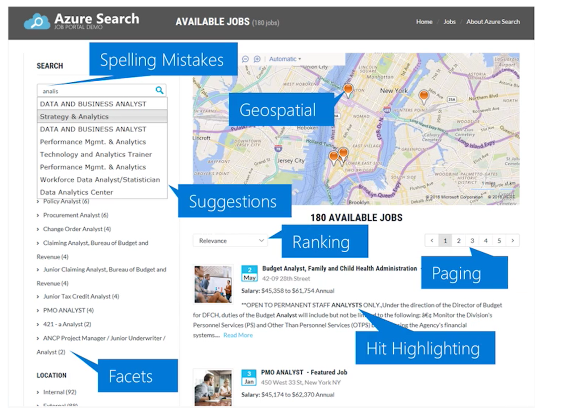
What Azure Search is

Slide 13
What Azure Search is
Formats
Microsoft Office
PDF
HTML
XML, JSON
ZIP
EML, RTF, TXT
JPEG, PNG, JPG
CSV
Data Sources
Azure SQL
Text columns
JSON/XML columns
SQL Server IaaS on Azure
CosmosDB
Azure blob storage
Azure Table
MySQL (PaaS and IaaS)
Azure Files (Private Preview)

Slide 14
What Cognitive Search is
Azure Search feature, Announced in May 2018 (MS Build)
It uses AI to create searchable metadata, transforming unstructured data into information
Data Enrichment =! Data Integration
Original data isn’t moved, changed or copied
Results are always loaded into an Azure Search Index
Public Preview… For now:
10+ regions, including South Central US, West Europe, North Europe, Brazil South, and Southeast Asia
Free, Azure Search regular cost only

Slide 15
What Cognitive Search is
Enrichment Pipeline
Unlock valuable information lying latent in all your content
Form 5471
Notes:
Another elevator pitch for you:
Azure Search is the Microsoft Cloud Service for knowledge mining.
It uses AI in a enrichment pipeline to unlock insights and context from your clients content. In other words, from your clients documents.
The Enrichment Pipeline concept is also important, we will use it in the next slides.

Slide 16
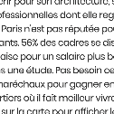


What Cognitive Search is
Enrichment Pipeline
Documents
Cutting-edge AI: Cognitive Skills
Fully text-searchable rich index
Key Phrase extraction
Location entity extraction
Sentiment analysis
Organization entity extraction
Persons entity extraction
Language detection
Form 5471
Face detection
Celebrity recognition
Tag extraction
Custom skills
Landmark detection
Printed text recognition
Notes:
These are the cognitive skills you can apply to your client’s documents. Some of them are pre built, you can select them with code but also with a few clicks in Azure Portal. This information is extracted and pushed into an Azure Search index for advanced data exploration.
But please notice the Custom skills option in the lower left corner. You can use ANY transformation you want, cognitive or not. Hosted on Azure or not. Public or not. It just need to be a REST API.
All of this skill are applied on your documents in the order you need, what is defined in the cognitive search enrichment pipeline.

Slide 17
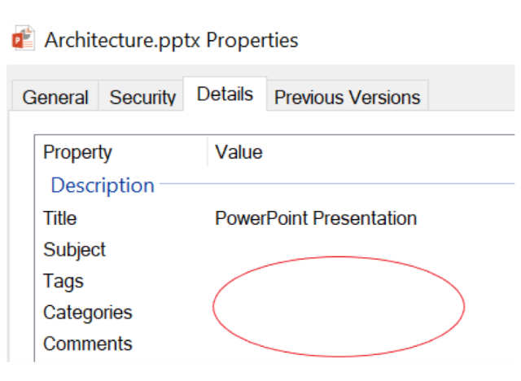


When to use it
Documents Analysis
Understanding engineering plans
Lack of Metadata
Notes:
Business cases

Slide 18
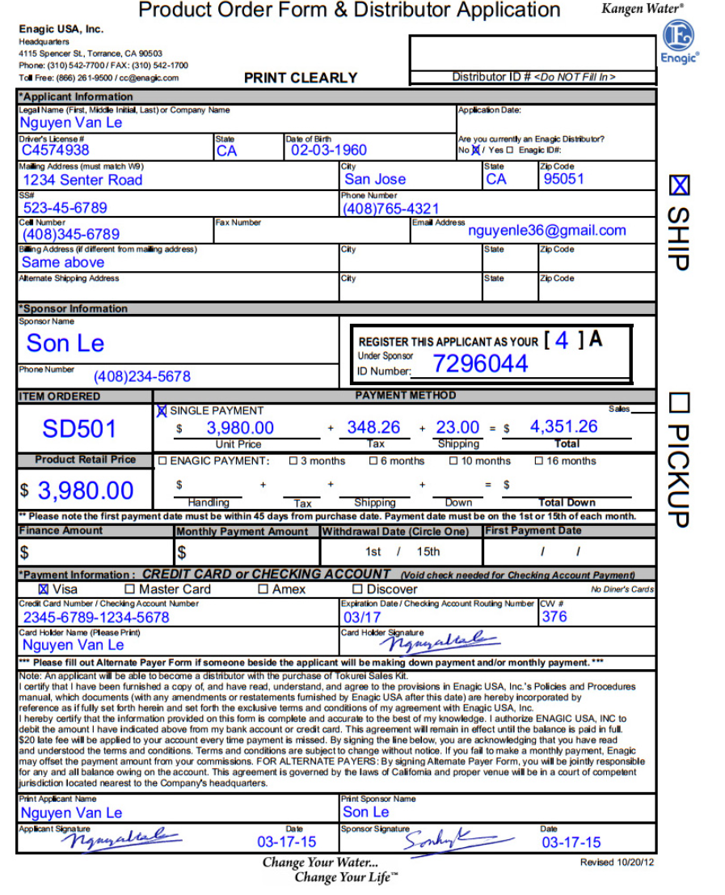
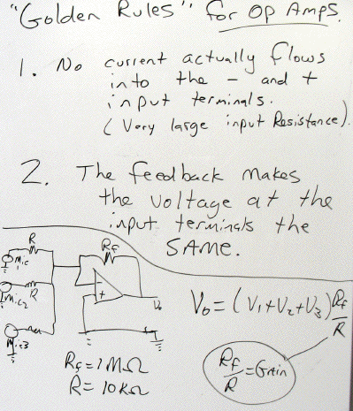
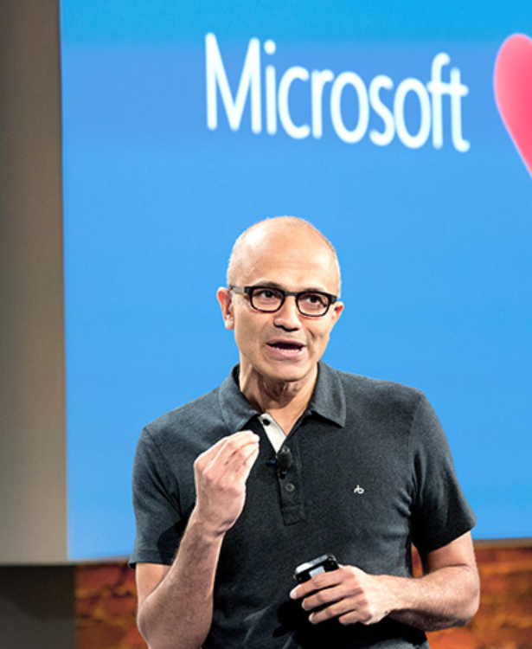
When to use It
Forms Reading
Handwritten Information
Image Analysis
Notes:
More use cases. Let’s use the browser to analyze this 3 documents.

Slide 19
When to use It
Dataset of this training!!
Forms Reading
Handwritten Information
Image Analysis
Notes:
More use cases. Let’s use the browser to analyze this 3 documents.

Slide 20
When to use It
How to identify Cognitive Search Opportunities
Every company has ppts, pdfs, docx, html, images…
Every company has contracts, forms, plans, memos, emails
Every company needs compliance, risk detection
Client needs a better search experience on top of business documents
Global companies with enterprise documents in multiple languages
Local file server is out of space
Client already has data on Azure
Client needs to apply AI to business documents: data != information
Notes:
Azure Search provides natural language processing in 56 languages

Slide 21
When to use It
How to identify CREATE Cognitive Search Opportunities
Every company has ppts, pdfs, docx, html, images…
Every company has contracts, forms, plans, memos, emails
Every company needs compliance, risk detection
Client needs a better search experience on top of business documents
Global companies with enterprise documents in multiple languages
Local file server is out of space
Client already has data on Azure
Client needs to apply AI to business documents: data != information

Slide 22
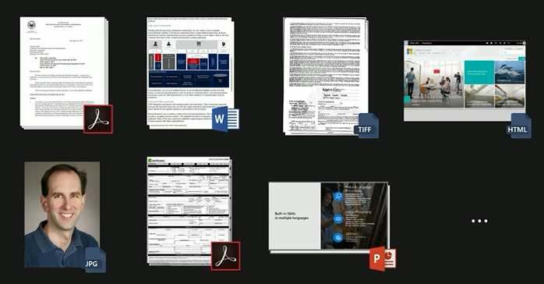
When to use It
How to identify CREATE Cognitive Search Opportunities
80% of relevant business information is unstructured, usually text.

Slide 23






How it works
Cognitive Search enrichment pipeline: Atomic cognitive processes, aka Cognitive Skills, applied for each document, creating metadata
Entity recognition skill
Language detection skill
Key phrase extraction skill
Notes:
The enrichment pipeline applies one or multiple cognitive services, or cognitive skills, for each document of your dataset.
In this example, we are using these 3 skills on a pdf file.

Slide 24
How it works
Predefined Cognitive Skills
Key Phrases
Language Detection
Text Merger
Entity Recognition: Names, Locations, Organizations
Sentiment Analysis
Text Splitter
Image Analysis: categories, tags, description, faces, type, colors, adult content
OCR
Shaper: Complex types (matrix) – Private Preview
Custom Skills
Any REST API
Public
Client Specific
Microsoft Cognitive Services
Create your own API
Industry specific
Hosted on Azure
Azure Functions
Web APP

Slide 25
How it works
Ingest
Any Data format
Any Azure Store
Enrich
Cognitive Skills
Explore
Azure Search API
Portal
Cognitive Search Pipeline

Slide 26






How it works – Cognitive Search Pipeline
Data
Source
Enriched
Documents
Ingest Enrich Explore

Slide 27
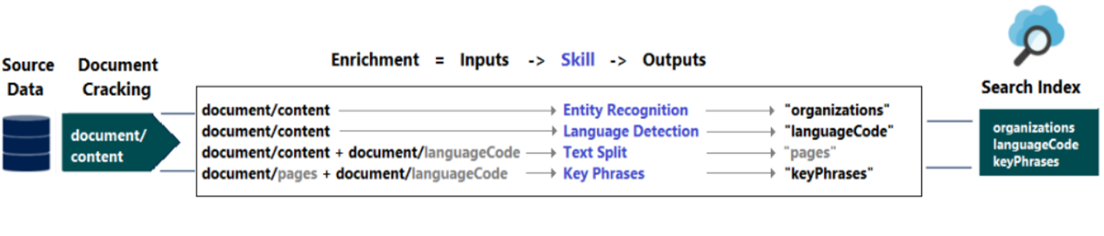
How it works – Cognitive Search Pipeline
Ingest Enrich Explore
Notes:
The enrichment pipeline adds annotations (outputs) to the document
Annotations can be simple or an array of elements
Elements can be referenced within the pipeline execution

Slide 28
How it works – Cognitive Skills
Ingest Enrich Explore
Create:
Data source
Skillset
Index
Indexer
Run:
Indexer
Ingest
Enrich
Index
Execution Status Check
Results Check
Query:
Azure Search
API
Explorer
.Net SDK

Slide 29
How it works – Old High Level Architecture
Cognitive Services APIs
Blob
Data
Azure Search
Explore
Web App
Web Job
Challenges
Development
Costs
Latency

Slide 30
How it works – New High Level Architecture
Data
Azure Search
Explore
Challenges
Development
Costs
Latency
Cognitive Search Pipeline
Portal, Azure Search APIs

Slide 31
Good Practices
Supplement the indexes with:
Natural Language Processing
Custom Analyzers (50+ Languages)
Fuzzy Search
Filtered Search
Scoring Profiles
Autocomplete (new – June 2018)
Synonymous (new – June 2018)

Slide 32
Good Practices
Results are always loaded into an Azure Search Index. But you can do extra Analytics: Create a Custom Skill to save the enriched metadata:
CosmosDB
Azure SQL json column
Blob Storage
Others
Roadmap: Automatic export of the enriched metadata

Slide 33
Good Practices
Clear Business requirements
SQL Server on-prem is supported but not recommended
Performance
SQL Server open to the internet
Use ADF to copy data to Azure
Co-locate the Azure Search Service with your data: Costs, Latency

Slide 34
Good Practices
Leverage Azure Free Account and Azure Search Free Tier
50 MB
5 Cognitive Skills, 3 Indexes
Keep it up and running – demo in minutes with clients own data
Security Trimming to filter content based on user identity
Multiple Indexes for the same dataset may be required
Ranking, languages, filters…

Slide 35
Good Practices
Incremental Updates for new files (portal or command line)
On Demand
File Watch
Schedule
Execution Overlap: The schedule essentially tells the indexer to proceed where it left off at the next hour.

Slide 36
Good Practices
Troubleshooting
Start with a small dataset
Make Sure your credentials are correct
See what works even if there are some failures
Check Status
Error Parameters
Enriched documents under the hood: saving the raw transformations into the index
Free and basic tears have limits for document sizes
Parallel Indexing
Maximum runtime

Slide 37
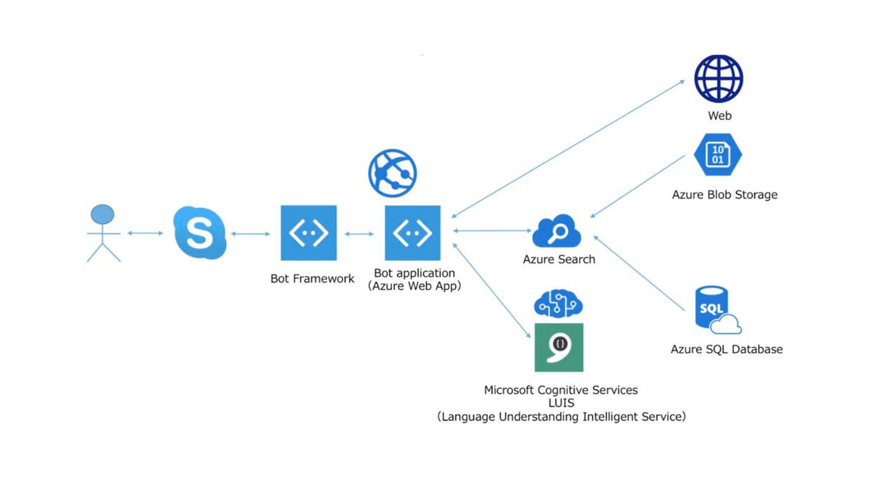
Good Practices
End to End Solutions
.NET SDK
REST API
BOT + LUIS

Slide 38
Demos – Cognitive Search
Enrichment Pipeline
https://text-analytics-demo-dev.azurewebsites.net/
JFK Files
https://jfk-demo.azurewebsites.net/
Business Documents Demo - Wolters Kluwer
https://wolterskluwereap.azurewebsites.net/
Oil & Gas Demo - Exxon Mobile
http://seismicsearch.azurewebsites.net/
Healthcare - CTakes
http://webmedsearch.azurewebsites.net/
Notes:
JFK – Search for Lee, KGB, Microsoft, Martin Luther King . Open Source data.
Wolters Kluwer – search for Microsoft, Risk + Fraud example in the landing page.
Exxon - It relates to seismic in the Oil and Gas domain. Open Source data. Try Kundsen or Chirp as search terms.
CTakes - pick any disease that you want and walk through a Cognitive Search implementation using custom skills based on Ctakes (an opensource software for medical extraction)
Cognitive Services – just use the suggested text

Slide 39
Additional Resources
http://aka.ms/LearnAI-trainings
http://aka.ms/LearnAI-csw
http://aka.ms/LearnAI-kmb
http://aka.ms/LearnAI-links

Slide 40
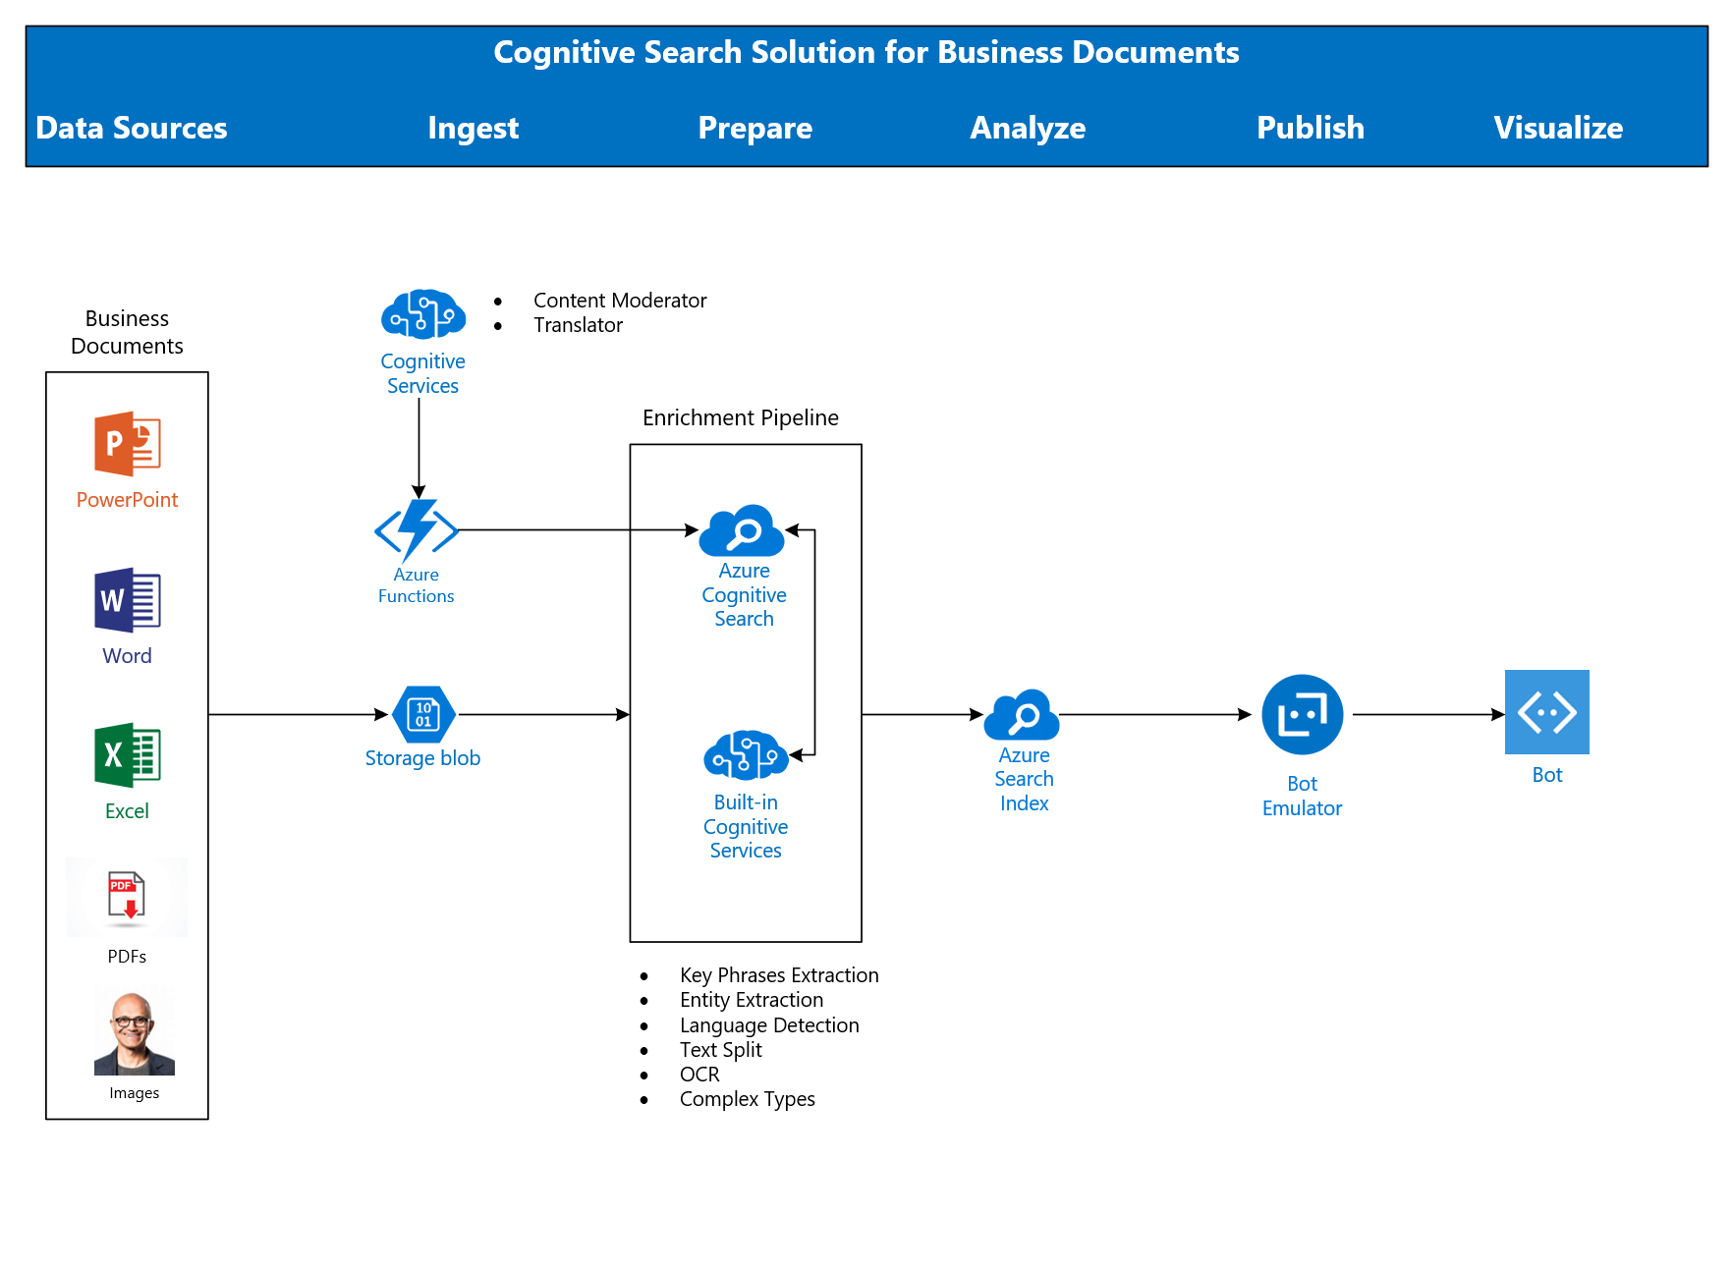
LearnAI – Knowledge Mining Bootcamp

Slide 41
9:30-11:30 Setup and lab 1 and 2

Slide 42
***Be sure to complete BEFORE Lab 9 https://github.com/Azure/LearnAI-Airlift
9AM-12PM
Setup***
Lab 9: Cognitive Search I: Text Skills
Lab 10: Cognitive Search II: Image Skills
Have extra time? Check out the Challenge: Custom Skills

